Slide 1
Chapter 7:
Using Methods

Slide 2
Objectives
Learn about methods and implementation hiding
Write methods with no parameters and no return value
Write methods that require a single argument
Write methods that require multiple arguments
Write a method that returns a value
Pass array values to a method
Learn some alternate ways to write a Main() method header
Learn about issues using methods in GUI programs

Slide 3
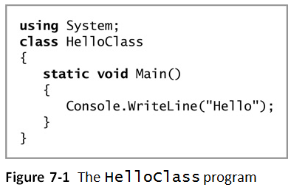
Understanding Methods and Implementation Hiding
Method
An encapsulated series of statements that perform a task
Using a method is called invoking or calling the method

Slide 4
Understanding Implementation Hiding
Implementation hiding
An important principle of object-oriented programming
Keeps the details of a method’s operations hidden
The only concern is the way you interface, or interact, with the method
The program does not need to know how the method works
Multifile assembly
A program that uses methods and classes stored in other files

Slide 5
Writing Methods with No Parameters and No Return Value
Major reasons to create a method:
The code will remain short and easy to follow
A method is easily reusable
Code bloat
Unnecessarily long or repetitive statements
A method must include:
Method declaration
Also called a method header or method definition
Opening curly brace
Method body
Closing curly brace

Slide 6
Writing Methods with No Parameters and No Return Value
Method declaration
Defines the rules for using the method and contains:
Optional declared accessibility
Optional static modifier
Return type for the method
Method name, or identifier
Opening parenthesis
Optional list of method parameters
Closing parenthesis

Slide 7
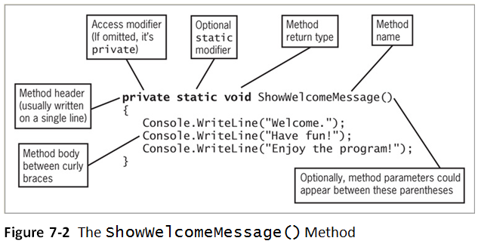
Writing Methods with No Parameters and No Return Value

Slide 8
An Introduction to Accessibility
Optional declared accessibility
Limits how other methods can use your method
Possible access values:
public
protected internal
protected
internal
private

Slide 9
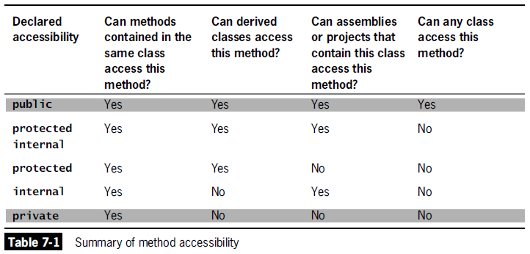
An Introduction to Accessibility

Slide 10
An Introduction to the Optional static Modifier
You can declare a method to be static or nonstatic
Methods are nonstatic by default
static method
Can be called without referring to an object
Instead, you refer to the class
Cannot call nonstatic methods
Nonstatic methods can call static ones

Slide 11
An Introduction to Return Types
Every method has a return type
Indicates what kind of value the method will return to any other method that calls it
If a method does not return a value, its return type is void

Slide 12
Understanding the Method Identifier
The method name must be a legal C# identifier
Parameter to a method
A variable that holds data passed to a method when it is called

Slide 13
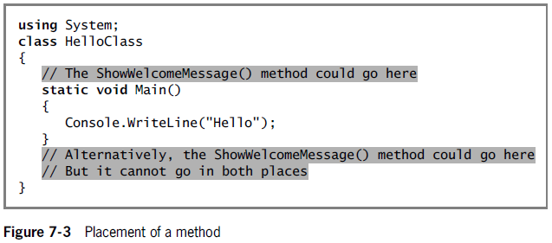
Placing a Method in a Class

Slide 14
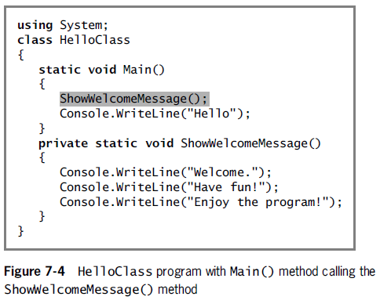
Placing a Method in a Class

Slide 15
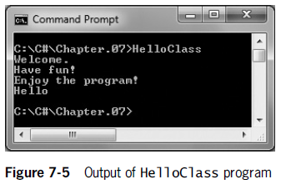
Placing a Method in a Class

Slide 16
Declaring Variables and Constants in a Method
Variables and constants can be declared in a method
They are considered local to that method
Their scope is defined by the boundaries of the method
Scope
The area in which a variable is known
They go out of scope when the method is exited
They are not accessible outside of the method except when passed as parameters to other methods

Slide 17
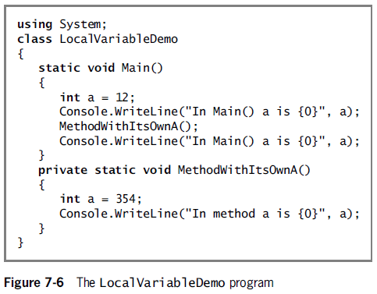
Declaring Variables and Constants in a Method

Slide 18
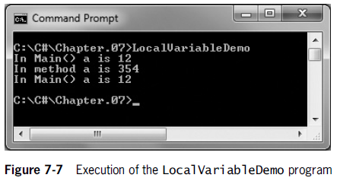
Declaring Variables and Constants in a Method

Slide 19
Writing Methods That Require a Single Argument
You need:
The type of the parameter
A local identifier (name) for the parameter
Local variable
Declared within a method
Formal parameter
A parameter in a method header that accepts a value
Actual parameters
Arguments within a method call

Slide 20
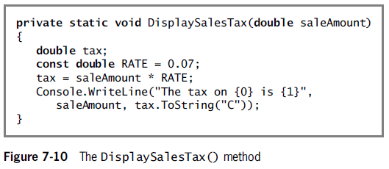
Writing Methods That Require a Single Argument

Slide 21
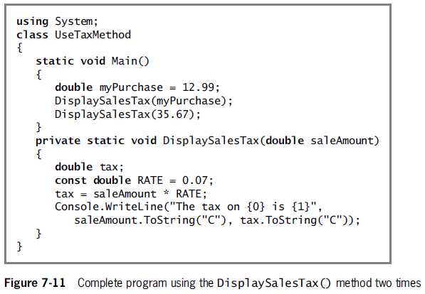
Writing Methods That Require a Single Argument

Slide 22
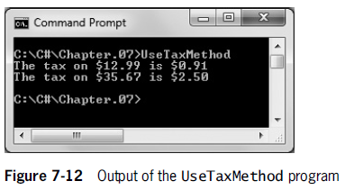
Writing Methods That Require a Single Argument

Slide 23
Writing Methods That Require Multiple Arguments
Methods can take any number of parameters
When you call the method, arguments must match in number, type, and relative position
The type qualification will be satisfied if an implicit cast (or automatic conversion) is possible
Examples
From int to long, float, double, or decimal
From float to double

Slide 24
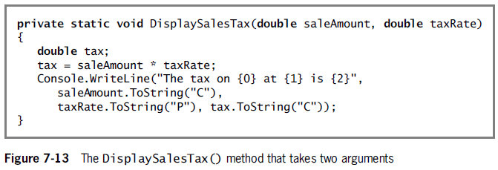
Writing Methods That Require Multiple Arguments

Slide 25
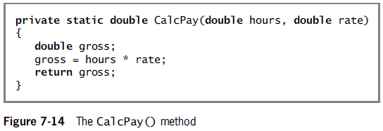
Writing a Method That Returns a Value
A method can return, at most, one value to a method that calls it
Method’s type
A method’s return type
return statement
Causes a value to be sent back to the calling method

Slide 26
Writing a Method That Returns a Value
A returned value can be:
Stored in a variable
Used directly
Nested method calls
Method calls placed inside other method calls
Writing a method that returns a Boolean value
When a method returns a value that is type bool, the method call can be used anywhere you can use a Boolean expression
Branching statements (e.g., if(…))
Loop control variables

Slide 27
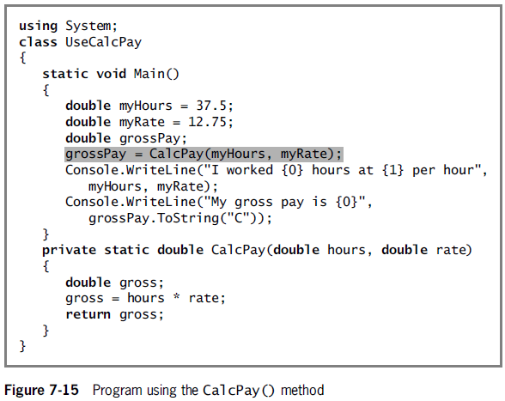

Slide 28
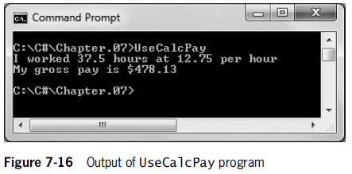
Writing a Method That Returns a Value

Slide 29
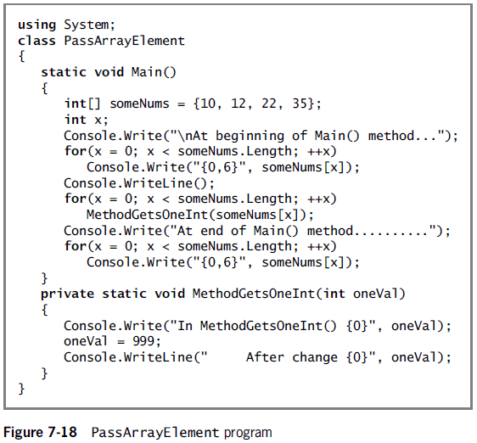
Passing a Single Array Element to a Method
You can pass a single array element to a method in the same manner as you would pass a variable
Variables are passed by value
Local variables store a local copy of the value

Slide 30
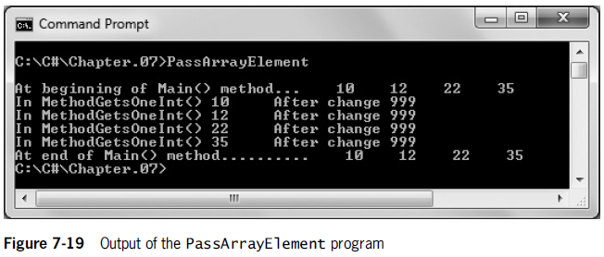
Passing a Single Array Element to a Method

Slide 31
Passing an Array to a Method
You can pass an entire array as a parameter
Arrays, like all objects but unlike built-in types, are passed by reference
The method receives the actual memory address of the array
Has access to the actual values in the array elements

Slide 32
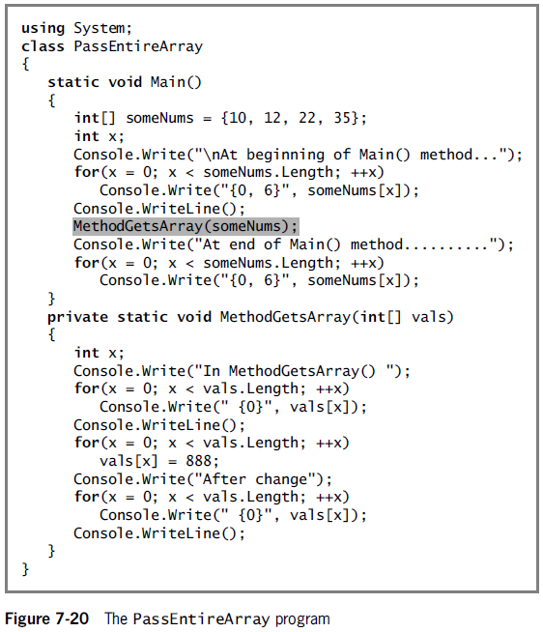

Slide 33
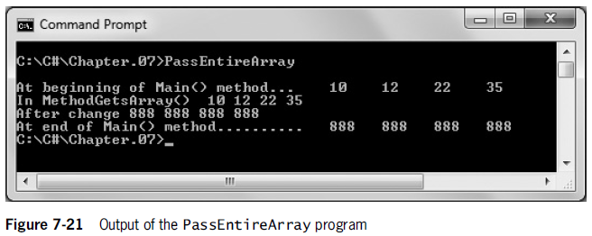
Passing an Array to a Method

Slide 34
Passing an Array to a Method
You can pass a multidimensional array to a method by indicating the appropriate number of dimensions after the data type in the method header
Example
public static void displayScores(int[,] scoresArray)
Jagged arrays insert the appropriate number of square brackets after the data type in the method header
Example
public static void displayIDs(int[][] idArray)

Slide 35
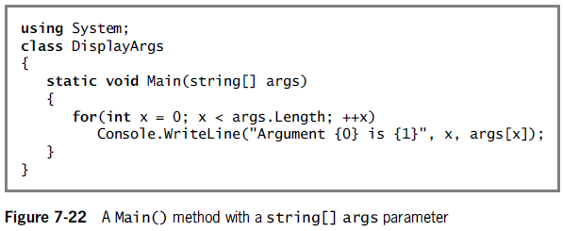
Writing a Main() Method with a Parameter List
Conventional way:
public static void Main()
Passing command-line arguments:
public static void Main(string[] args)

Slide 36
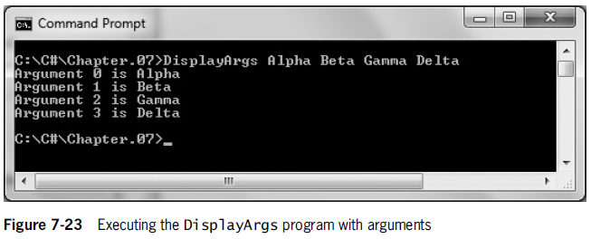
Writing a Main() Method with a Parameter List

Slide 37
Writing a Main() Method with an Integer Return Type
Some programmers prefer to write Main() method headers with a return type of int instead of void
The last statement in the Main() method must be a return statement
A return code of 0 indicates a successful execution
Any other value can be interpreted as an error code

Slide 38
Writing a Main() Method with public access
Some programmers prefer to write Main() method headers with public access
The default is private access
A public Main() method can be called by another class
The call must be made using the fully qualified name

Slide 39
Issues Using Methods in GUI Programs
Some special considerations are necessary when creating GUI applications
Understanding methods that are automatically generated in the visual environment
Appreciating scope in a GUI program
Creating methods to be nonstatic when associated with a Form

Slide 40
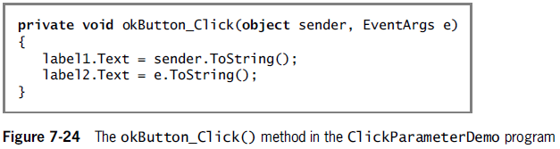
Understanding Methods That Are Automatically Generated in the Visual Environment
When you create GUI applications using the IDE, many methods are generated automatically
To create the method, double-click on the object

Slide 41
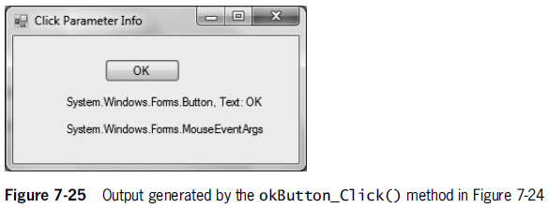
Understanding Methods That Are Automatically Generated in the Visual Environment

Slide 42
Appreciating Scope in a GUI Program
When you declare a variable or constant within a method, it is local to that method
If a variable or constant is needed by multiple event-handling methods, the variables or constants in question must be defined outside the methods (but within the Form class)
Automatically generated event-handling methods have predefined sets of parameters

Slide 43
Creating Methods to Be Nonstatic When Associated with a Form
When you create a GUI application and generate a method, the keyword static does not appear in the method header
The method is associated with an object from which the method-invoking events are sent

